Slide 1


Intro to Web Development
Nina Zakharenko
Brian Holt
bit.ly/1jXij63

Slide 2
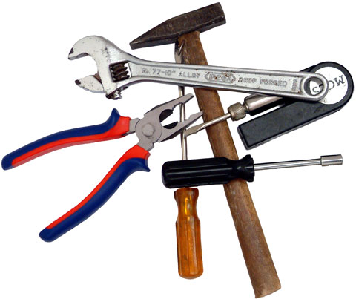
Tools

Slide 3
A good toolkit is important.
Why?
The tools of the trade are designed to help us solve problems faster.

Slide 4
The Tools you Need
A good text editor
A way to debug your HTML, CSS, and Javascript

Slide 5



Our Toolbox

Slide 6


Sublime: Syntax Highlighting
Colors help differentiate between different parts of your code.

Slide 7
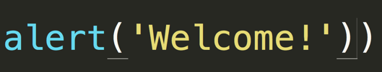

Sublime: Match Parenthesis

Slide 8
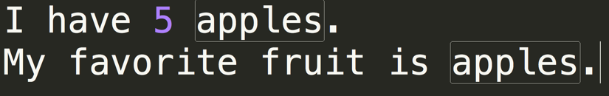
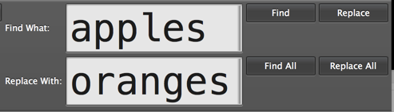
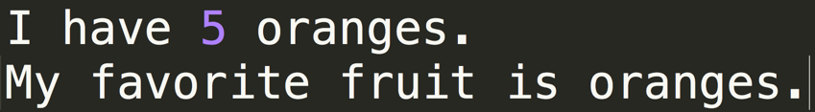
Sublime: Replace All

Slide 9
Debugging a web page

Slide 10
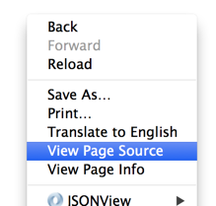
Chrome: View Source
Visit www.google.com
Right Click -> View Page Source

Slide 11
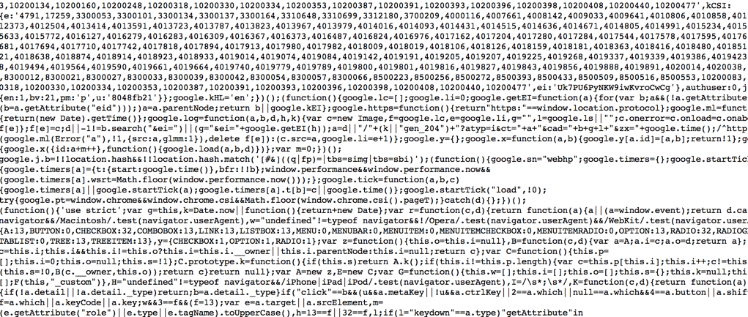
Whoa.

Slide 12
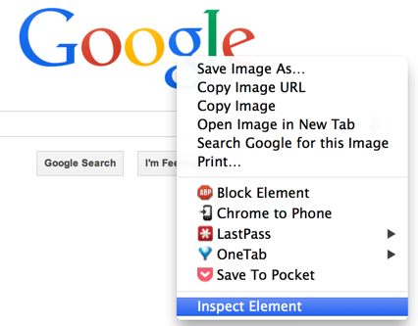
Better Way - Inspect Element

Slide 13
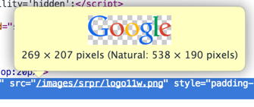
Much Better.

Slide 14

Chrome: Updating Values
Double click on the field you want to change.
Enter the new value, and press enter to see your changes.

Slide 15
Update Values
Note: Your updates are only on your local machine.
If you refresh the webpage, your updates will be gone.

Slide 16
Updating Values: Exercise
Let’s stretch out the google logo.
Navigate to http://www.google.com
Inspect Element on the Google Logo
Find the width value, set it to 700.
Find the height value, set it to 30.

Slide 17
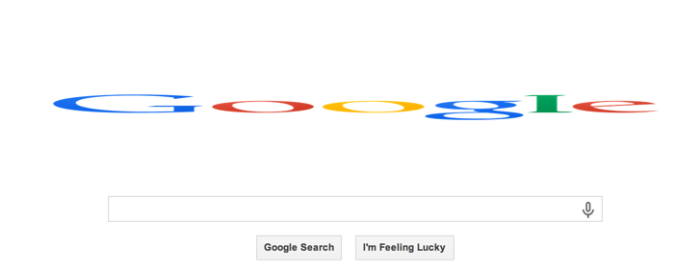
Updating Values: Results

Slide 18
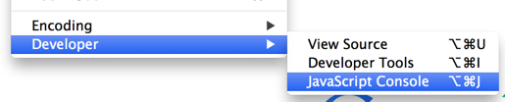
Chrome: Javascript Console
View -> Developer -> Javascript Console

Slide 19
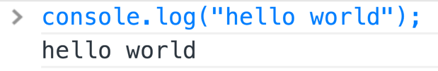
Interactive Javascript
Open Open the Javascript Console.

Slide 20
Chrome: Javascript Errors
If your Javascript has errors, you’ll see an indicator in the developer toolbar.

Slide 21

Client & Server

Slide 22
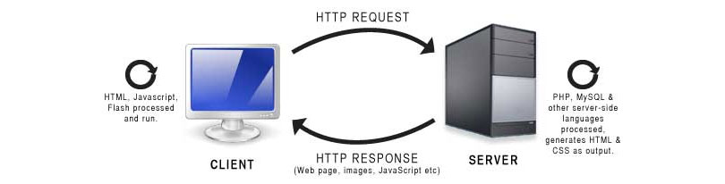
HTTP Request & Response

Slide 23

What happens?
When a link is clicked, the browser creates an HTTP Request that is sent to the server.

Slide 24

The Server handles the request

Slide 25
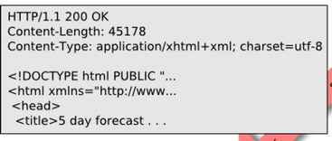
3. The Server Responds

Slide 26
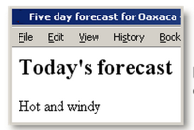
The Browser Displays the Page

Slide 27
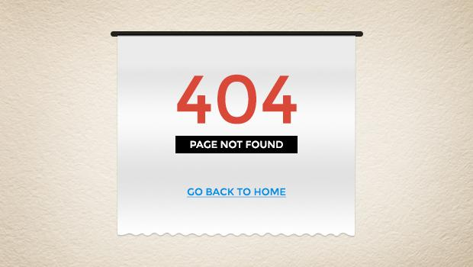

Slide 28
Common HTTP Status Codes
200 - OK
404 - Resource not found
500 - Server Error

Slide 29
Status Code Ranges
100s are informational
200s are successes
300s are redirection (something moved)
400s are client errors
500s are server errors

Slide 30

HTML
Hypertext Markup Language

Slide 31
What is HTML?
It is the content of your web page. If you have a blog, the HTML will describe the different sections of your page and will actually have the words of your blog post.

Slide 32
What is HTML?
HTML is not style. It does not describe how the page is arranged, the color, or the background image. That is CSS.

Slide 33
What is HTML?
HTML is made up nested tags. You start with the most general and nest it, becoming more specific.

Slide 34
<car>
<engine>
<transmission></transmission>
<radiator></radiator>
</engine>
<stereo>
<cd-player></cd-player>
<fm-radio></fm-radio>
</stereo>
</car>

Slide 35
<team>
<defense>
<defensive-backs>
<corner-back>Richard Sherman</corner-back>
<free-safety>Earl Thomas</free-safety>
<strong-safety>Kam Chancellor</strong-safety>
</defensive-backs>
</defense>
<offense>
<wide-receivers>
<wide-receiver>Doug Baldwin</wide-receiver>
<wide-receiver>Golden Tate</wide-receiver>
</wide-receivers>
</offense>
</team>

Slide 36
<html> <head> <title>My first web page</title> </head> <body> <h1>My very first web page</h1> <p> This is pretty much the most awesome thing ever. Seriously. </p> </body> </html>
http://codepen.io/btholt/pen/hadGL

Slide 37
HTML Tags - Meta
<html> - Encompasses your entire document.
<head> - Where all your meta-data goes. Nothing in here gets displayed.
<body> - Where all your content goes. This is the stuff that will be displayed.

Slide 38
HTML Tags - Content
<h1>, <h2>, … <h6> - Headers or titles. h1 is the most important or “top level.”
<p> - Denotes a stand-alone paragraph.
<div> - A division or container of content. Used to group like objects together.

Slide 39
HTML Tags - Content
<ul> - An unordered list. These bullet points are an unordered list. Implies no order.
<ol> - Ordered list. Any list that implies some order (usually has leading numbers.)
<li> - An element of a list. In this case, an individual bullet point.

Slide 40
<h1>My favorite social media sites</h1> <ol> <li>reddit</li> <li>Twitter</li> <li>Instagram</li> </ol>
http://codepen.io/btholt/pen/njfLl

Slide 41
Exercise
Create a new page that has a title.
Create an unordered list of things you look for in a car.
Create an ordered list of your favorite cars.
Give each a title

Slide 42
http://codepen.io/btholt/pen/axvAd

Slide 43
HTML Tags - Inline
<strong> - Usually bold. Used for something you want to stand out.
<em> - Usually italics. Used for something you want emphasis on.
<span> - Like div for inlines. Used for something you want to separate from other things. Becomes useful with CSS.

Slide 44
This is an <strong>awesome</strong> class. I <em>love</em> it.
http://codepen.io/btholt/pen/wInbm

Slide 45
HTML Tags - Void Tags
Some tags don’t need a closing tag; they can’t have anything in them. In these cases, the tags close themselves. A good example is an input tag.
<input />

Slide 46
HTML Tags - Attributes
Sometimes tags need additional meta-data. The img tag is a great example of that.
<img src=”http://placekitten.com/400/400” />

Slide 47
http://codepen.io/btholt/pen/vewaA

Slide 48
HTML Tags - Grouping
Like we said before, it’s a good idea to group tags by some idea.
If you were doing a blog post, you would group together individual blog posts.
http://codepen.io/btholt/pen/njGdE

Slide 49
HTML - Classes
Those previous groupings were useful, but to someone who had never seen the code before, you wouldn’t know what it was a group of. For that, we’ll use classes.

Slide 50
<div class="picture-group"> <img src="http://placekitten.com/400/400" /> <img src="http://placekitten.com/200/600" /> </div>
http://codepen.io/btholt/pen/ywAjc

Slide 51
HTML - IDs
Classes can (and should be) used multiple times throughout a page. If you have multiple blog posts, you should multiple blog-post classes used.
IDs are unique. There can only be one of an ID on a page. You would only have blog-post-1 ID or one blog-post-2 ID.

Slide 52
<div id="group-1" class="picture-group"> <img src="http://placekitten.com/400/400" /> <img src="http://placekitten.com/200/400" /> </div> <div id="group-2" class="picture-group"> <img src="http://placekitten.com/100/400" /> <img src="http://placekitten.com/350/400" /> </div>
http://codepen.io/btholt/pen/wfIJD

Slide 53
HTML Tags - Naming
It’s tempting to give your classes name like left-group or purple-container. Don’t give them “presentational names.” What if you need to move the left-group to the right? Or the purple-container is now green? You don’t want to have to rename everything.

Slide 54
Exercise - Giving Classes
Open http://codepen.io/btholt/pen/njGdE
Give appropriate class names to all the h1, p, and divs.
Give the blog posts appropriate IDs.

Slide 55
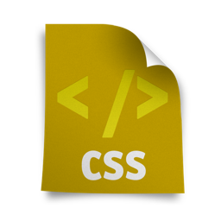
CSS
Cascading Style Sheet

Slide 56
CSS - What is CSS?
While HTML is the content, CSS is the style, the presentation of the content. CSS dictates how the HTML looks.
CSS is a collection of rules. If certains are met, then a style is applied to it.

Slide 57
body { color: red; }
http://codepen.io/btholt/pen/eFoIn

Slide 58
body { color: red; } p { color: green; }
http://codepen.io/btholt/pen/GFImi

Slide 59
CSS - Better Practices
What we’ve done works so far. However, try adding another <p> to the previous pen. It will also be green. What if we want one <p> to be blue and one to be green?
http://codepen.io/btholt/pen/vlryG

Slide 60
CSS - Classes
Classes are used extensively for styling. Notice the leading period in .leading-p: that denotes that it is a class.
There are different rules for styles “winning out,” or stated differently, when two styles conflict, which one gets applied. We’ll talk about it in a sec.

Slide 61
http://codepen.io/btholt/pen/echKA

Slide 62
CSS - Text Properties
color - Change the color of the text.
font-weight - Change it from normal to bold.
font-style - Change the text from normal to italic.
text-align - Left, right, or center.
text-indent - Indent paragraphs.
font-size - How big the text is

Slide 63
CSS - Measurements
CSS has a whole bunch of measurements for legacy reasons: px, pts, em, ex, rem, in, mm, cm, etc. With few exceptions, px and em are the two you want to use (depending what context you’re in.)

Slide 64
CSS - Measurements
px - Pixels. While not necessarily uniform across browsers (FireFox has a different pixel measurement vs Chrome) it will be uniform across your page.
em - M’s. It’s how wide an ‘m’ is in the current font. Good for relative sizes that scale with a font.

Slide 65
CSS - Boxes
width / height - Obvious, hopefully.
border - The border around your box. Examples:
1px solid black
3px dashed gray
5px dotted #663399
background-color - The color of the background
background-image - A URL to the background image

Slide 66
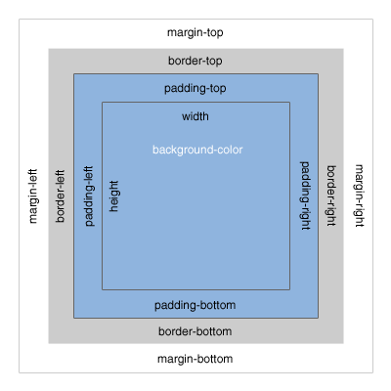

Slide 67
http://codepen.io/btholt/pen/DlsLE

Slide 68
http://codepen.io/btholt/pen/echKA

Slide 69
CSS - Document Flow
CSS has a concept called float. You can have divs “float” next to each other instead of each one on a new line. The browser will try to fit as many divs next to each other until there isn’t any room left, at which point it’ll wrap to the next line.

Slide 70
http://codepen.io/btholt/pen/HamlJ

Slide 71
http://codepen.io/btholt/pen/ebkJG

Slide 72
Exercise: Styling a Page
Open http://codepen.io/btholt/pen/uHzfL
Recreate http://i.imgur.com/0dnCF58.png without changing the HTML
Leave the box-sizing. It makes it easier.

Slide 73
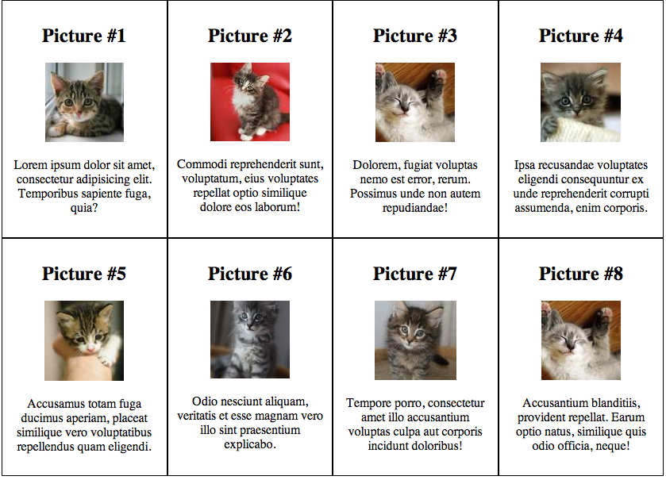
codepen.io/btholt/pen/uHzfL
i.imgur.com/0dnCF58.png
Solution:
codepen.io/btholt/pen/kcuea

Slide 74
CSS - Conclusion
CSS, like HTML, has a lot of stuff to it. It’s impossible to keep it all in your head. Don’t expect to memorize all of it. Use sites like the MDN, CSS-Tricks, and Stack Overflow when you need help.

Slide 75

JavaScript
An Introduction to Programming

Slide 76
How is JS different from HTML?
HTML tells your browser how a web page is going to look.
Javascript is interpreted by your browser.

Slide 77
What is it used for?
Javascript is used for anything from creating a pop-up when a user clicks on something, to full fledged games.

Slide 78
Statements
Each line in JavaScript is an instruction.
When the browser reads it, it executes that line of code.
console.log(“Hello”);

Slide 79
Statements
; - what’s this thing??
; is a semi-colon
think of a javascript statement as a sentence, and a semi-colon as a period.

Slide 80
JavaScript - Comments
// Comments start with two forward slashes.
/* Multi-line comments can be long */

Slide 81
Comments - Rule of Thumb(s)
Comments can be used to explain complex or complicated code.
There is no need for obvious comments
Remember, when you go back and update your code, comments should be updated too.

Slide 82
Seeing Results
// will popup a dialog
alert(“hello popup”);
// will output directly to the html page
document.write(“hello document”);
// will display in the console
console.log(“hello console”);

Slide 83
Exercise: Seeing results
http://codepen.io/nnja/pen/Inypi?editors=001

Slide 84
JavaScript - Variables
Variables are used to store values.
Declare and initialize on one line:
var y = 2;
or two:
var x; x = 5;

Slide 85
Don’t forget the var!
Always use the var keyword when declaring a variable for the first time.
If you don’t other parts of the code can accidentally overwrite it.

Slide 86
JavaScript Variables - Naming
Variables are case sensitive!
Naming convention:
Variables start with lower case letter, $ or _
Don’t contain special symbols % # !
written in camelCase

Slide 87
JavaScript - Reserved Words
Some words are reserved and can’t be used as variable names.
Examples:
For a full list of reserved words - http://www.w3schools.com/js/js_reserved.asp
case | catch | for
let | private | this
with | in | do

Slide 88
JavaScript - Variable Types
Strings - Used to store a series of characters.
var myName = “Nina”;
Numbers - With or without decimal.
var year = 2014; var pi = 3.14;

Slide 89
JavaScript - Variable Types
Boolean
True (Yes)
var isNice = true;
False (No)
var hasCake = false;

Slide 90
JavaScript - Special Types
The value of a variable which is not yet declared is called undefined.
var cars; // Value is undefined
Variables can be emptied by setting the value to null. person = null; // Value is null

Slide 91
Our First Javascript
// Let's use Javascript to popup something about us
var myName = “Nina”; alert(“My name is ” + myName);

Slide 92
Exercise
http://codepen.io/nnja/pen/nzspH/?editors=001

Slide 93
Operators
+ | Addition
- | Subtraction
* | Multiplication
/ | Division
% | Modulus

Slide 94
JavaScript - Expressions
Variables can also store the results of expressions.
var x = 2 + 2; var y = 5 * 6; var name = “Nina”; var greeting = “Hello ” + name;

Slide 95
Increment & Decrement
++ | Increment
-- | Decrement
var x = 5; x++; // x will be 6 x--; // x will be 5

Slide 96
JS - Comparisons
== | equal to
=== | equal value and type
!= | not equal to
!== | not equal value or not equal type
>, >= | greater than, greater than or equal
<, <= | less than, less than or equal

Slide 97
JavaScript - Equality Comparison
var numApples = 3; numApples == 3 // true numApples == “3” // true // Strict Equality numApples === “3” // false

Slide 98
JS - Logical Operators
&& | AND
|| | OR
! | NOT

Slide 99
JS - Logical Operators Example
var x = 5; var y = 3; console.log(x < 4 && y < 4); >> false console.log(x < 4 || y < 4) >> true

Slide 100
JavaScript - Arrays
Arrays are a list of variables.
They are written with square brackets. [ ]
var fruits = ["Peach", "Orange", "Apple"];

Slide 101
JavaScript - Arrays
Arrays have a length property, so we can find out how many items are in them.
var fruits = ["Peach", "Orange", "Apple"];
fruits.length >> 3

Slide 102
JavaScript - Access Items in Array
Use square brackets to access an item in an array.
var myFruit = fruits[0];
Array access is zero based. To access the first element, use [0].
console.log(myFruit); >> Peach

Slide 103
Exercise: Arrays
http://codepen.io/nnja/pen/zCHtf?editors=001

Slide 104
JS - Change / Add item in List
var fruits = ["Peach", "Orange", "Apple"];
// Change item in 2nd position. fruits[1] = "Pineapple"; console.log(fruits); >> ["Peach", "Pineapple", "Apple"] // Add Orange to List of Fruits fruits.push("Orange") // Returns the new length of the array. ["Peach", "Pineapple", "Apple", "Orange"]

Slide 105
JavaScript - If Statement
Use if to tell JS which statement to execute, based on a condition that is true.
var apples = 8; if (apples > 0) { console.log(“Eat An Apple”); }

Slide 106
JS - If Else
if (apples > 0) { console.log("Eat An Apple"); } else { console.log("No apples left."); }

Slide 107
JS - If, Else, Else If
if (apples > 0) { document.write("Eat An Apple"); } else if (apples < 3) { document.write("Go to the store."); } else { document.write("No apples left."); }

Slide 108
Exercise - The If statement
http://codepen.io/nnja/pen/qfIBK?editors=001

Slide 109
JS - For Statement
for (<counter> ; <counting to> ; <increment counter>) { <expression>
}
The <counter> is a variable used to keep track of what step you’re on.
The <counting to> is the goal. It’s how many total steps we want to take.
The <increment counter> is how we change the variable to get to the goal.

Slide 110
JS - For Statement
var text = "numbers: "; for (var i = 0; i < 5; i++) { text += " " + i; } console.log(text); >> "numbers: 0 1 2 3 4"

Slide 111
Iterating over Array
var fruits = ["Peach", "Orange", "Apple"]; for (var i=0; i<fruits.length; i++) { console.log(fruits[i]); }
// We’re counting up to fruits.length. It doesn’t matter how long the array is.

Slide 112
Exercise - Iterate over an Array
http://codepen.io/nnja/pen/zaqBI?editors=001

Slide 113
Functions
Functions are a way of repeating the same action multiple times.
Functions can be called multiple times.

Slide 114
Anatomy of a Function
var printList = function(list) { for (var i=0; i<list.length; i++) { console.log(list[i]); }; };

Slide 115
Running Functions
Declaring a function is different from a statement.
The code in a function will not be run until you explicitly call it.

Slide 116
Functions Exercise
http://codepen.io/nnja/pen/aumdH?editors=001

Slide 117
Calling a function
var fruits = ["Peach", "Orange", "Apple"]; var printList = function(list) { for (var i=0; i<list.length; i++) { console.log(list[i]); }; }; printList(fruits);

Slide 118
Scope
Variables defined in functions can only be used in those functions.
So what happens when you forget to use var?
http://codepen.io/nnja/pen/ocLDG?editors=001

Slide 119
http://codepen.io/btholt/pen/pzBCl

Slide 120
JavaScript Objects
Objects are collections are of properties. They can contain numbers, strings, functions, arrays, even other objects.
They’re useful for containing like-properties.

Slide 121
JS Objects
var car = {
make: “Telsa”,
model: “Model S”,
acceleration: 30,
accelerate: function() {
this.accelerate += 10
}
}

Slide 122
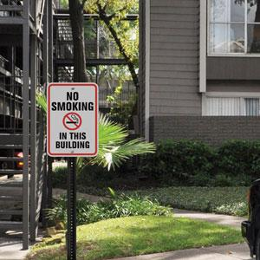

Slide 123
JavaScript - Context
Context refers to what this means.
What this means depends on what context the function is called from, much like the preceding sign.
Depending on where this called, it means different things. It can be source of bugs. Be careful.

Slide 124
http://codepen.io/btholt/pen/BLtiv?editors=001

Slide 125
http://codepen.io/btholt/pen/iFodm?editors=001

Slide 126
Other topics not covered here
do / while loops
Inheritance
Switch statements
A boatload of DOM interactions (other than document.write)
Newer “ES6” syntax
Much, much more. JavaScript has been around a while and has a lot to it.

Slide 127

Using JavaScript to manipulate the DOM

Slide 128
jQuery - What is jQuery?
jQuery is JavaScript toolkit. It’s JavaScript someone else wrote to make writing it easier.
Its main purpose to make common tasks in JavaScript (like changing info on the page) easier and shorter.
Used on some 80% of the top sites in the world.

Slide 129
jQuery - Telltale Sign
If you see something looks
$(‘... stuff in here ...’)
then it’s probably jQuery. jQuery uses the $ a lot.

Slide 130
jQuery - Simple example
$(‘.caption-text’).text(‘Magic!’);
http://codepen.io/btholt/pen/aopKv

Slide 131
jQuery - Chaining
$(‘.caption-text’)
.text(‘Magic!’)
.css(‘background-color’, ‘orange’);
http://codepen.io/btholt/pen/wdgiB

Slide 132
Exercise - Set text
Open http://codepen.io/btholt/pen/lbwuI
Using jQuery, make it so when the button is clicked, whatever text in the <input/> is set as the text of the <p>.
Do not modify the HTML.
Hint: you’ll need .text(), .val(), and .click().
Solution: http://codepen.io/btholt/pen/Gyqri

Slide 133
jQuery - Responding to Users
$(‘.alert-btn’).click(function() {
alert(‘Hey there!’);
});
http://codepen.io/btholt/pen/ujlEz

Slide 134
jQuery - Get text from an input
var name = $(‘.name-input’).val();
alert(name);
http://codepen.io/btholt/pen/Elfjs

Slide 135
jQuery - Other Cool DOM Functions
.css() - Get or update CSS values.
.html() - Set the inner HTML of an element.
.show() / .hide() - Displays / hides an element.
.addClass() / .removeClass - Add or remove a class.
.append() - Add an element to the existing elements in an element

Slide 136
jQuery - Other functions
jQuery has over 300 functions. It’s huge. And it has great documentation and a great community. If you want to know how to do something, just search for “jQuery how to hide div” and it’ll come up. Stack Overflow is great.

Slide 137
AJAX
Stands for Asynchronous JavaScript and XML. It’s really a misnomer. It’s just a buzzword that stuck.
Means making requests to a server without refreshing the page.
jQuery makes it dead simple with its .ajax() method.

Slide 138
http://codepen.io/btholt/pen/FArdh

Slide 139
http://codepen.io/btholt/pen/mjBkq
Putting some concepts together

Slide 140
Exercise: Displaying Data from reddit
Open http://www.reddit.com/r/aww/search.json?q=puppy&restrict_sr=true
If you want to see the API documentation, it’s here: http://www.reddit.com/dev/api#GET_search
Open the CodePen http://codepen.io/btholt/pen/Aejsl
Hints:
Solution: http://codepen.io/btholt/pen/fErah
You’ll need the jQuery methods .click(), .append(), and .ajax()
You shouldn’t need to touch HTML or CSS.
The data is fairly nested. The data that concerns you is data.children[i].data.thumbnail. children is an array you’ll loop over.

Slide 141
Intro to Command Line

Slide 142
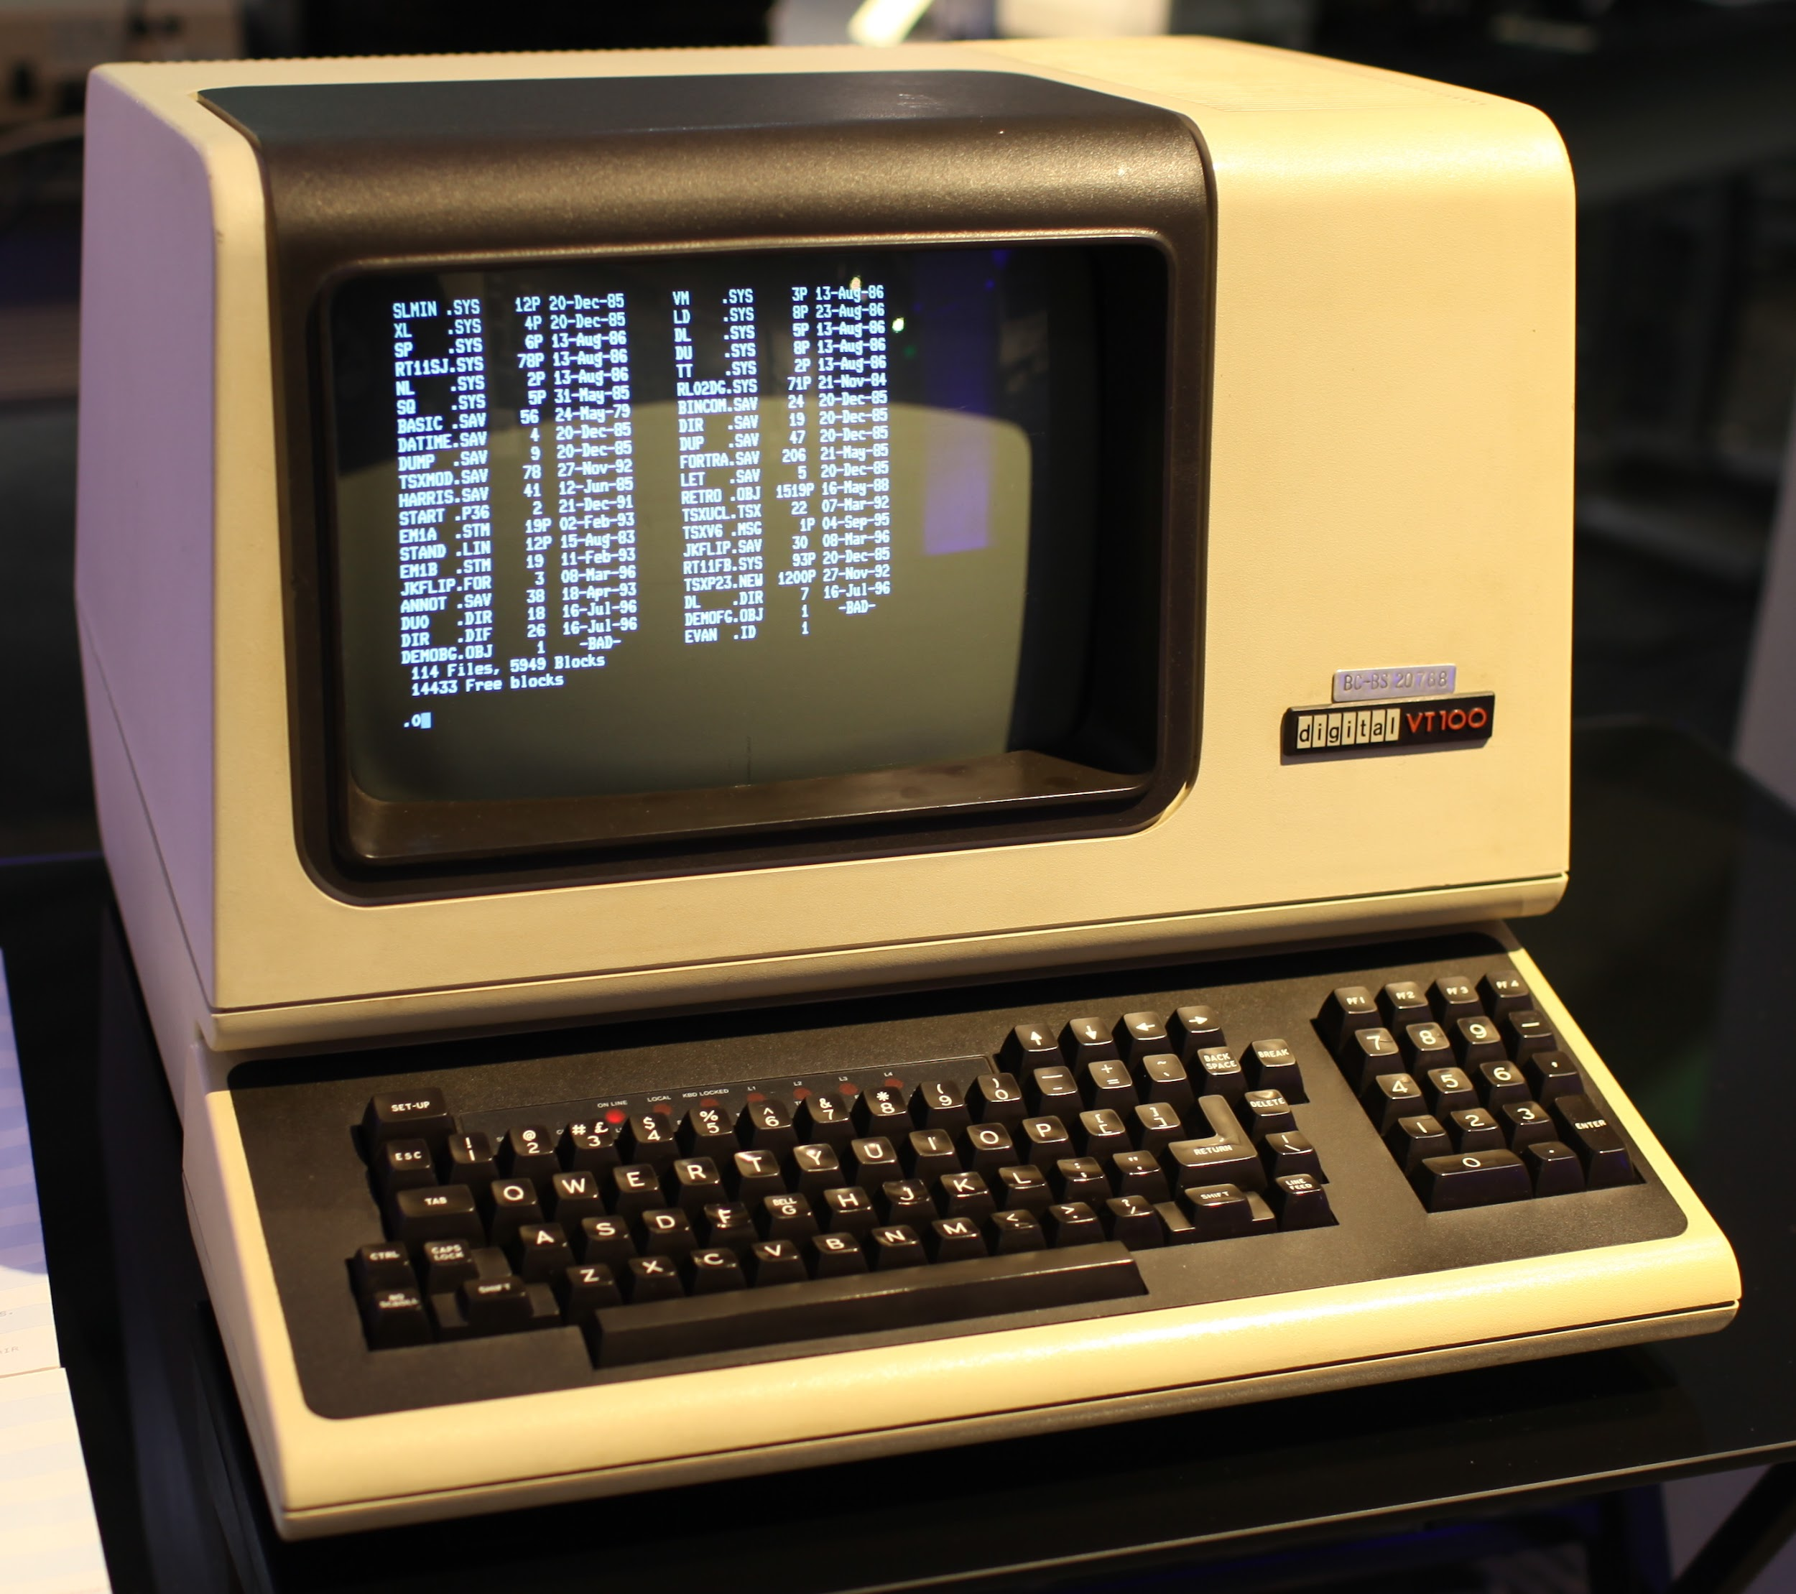

Slide 143



Windows vs Mac vs Linux

Slide 144
Why do we still use it today?
Completing repetitive tasks is faster
Tasks can be automated
This is called scripting
Parameters can be specified
Parameters are a way of customizing how a command is run.

Slide 145
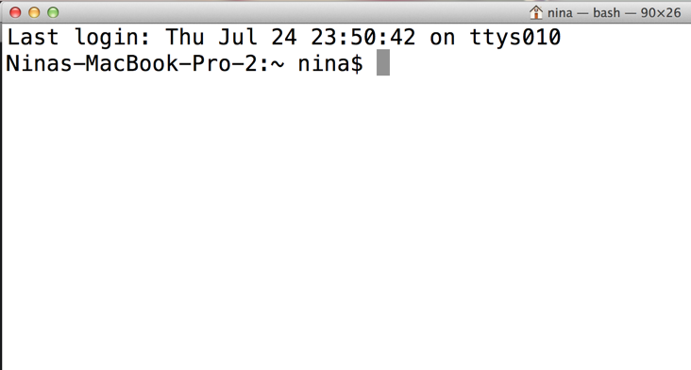
The Command Prompt

Slide 146
Home Directory
Mac/Linux:
$ cd
/Users/<username>
Windows:
C:\Users\<username>

Slide 147
What directory am I in?
Linux/Mac OS
$ pwd
/Users/nina
(pwd stands for print working directory)
Windows
$cd
(cd stands for current directory)

Slide 148
Listing Directory Contents
$ cd ~/Desktop
$ ls
folder/
file.txt
$ dir C:\windows

Slide 149

Case sensitivity
File names in linux and mac os are case sensitive.
That means myfile.txt != MyFile.TXT
UNLESS, you use windows.
Windows don’t care.

Slide 150
Navigate to a different Directory
linux/mac os
$ cd Desktop
tip: cd stands for change directory
windows
$ chdir C:\windows

Slide 151
Navigate up one directory
$ cd ~/Desktop/painting/
$ pwd
/Users/nina/Desktop/painting
$ cd ..
pwd
/Users/nina/Desktop

Slide 152
Paths - Relative/Absolute
The starting for relative paths is the directory you are in.
The starting for absolute paths in the root directory. It’s just / on linux, or C:\ on windows.

Slide 153
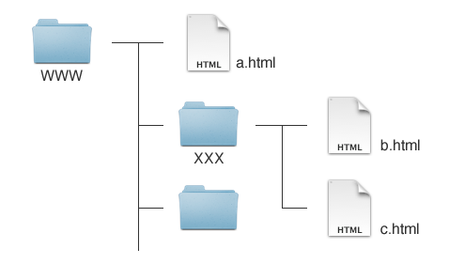

Slide 154
Git / Github
Git is an open source version control system.
Advantage: Maintain history of changes
Can use a remote server for backup
Github.com is a popular website with features built on top of this tool.
You can find tons of free projects!

Slide 155

Forking
https://github.com/btholt/pull-requests

Slide 156

Cloning a Repository
Navigate to a github.com Repository.
Copy Clone URL:

Slide 157
Cloning a Repository
Open your terminal, and navigate to a folder you’d like to save files in.
type:
git clone <your repo url>
This will copy the files to your computer.

Slide 158
Git Status
This is the git command you will use the most.
$ git status
On branch master
Your branch is up-to-date

Slide 159
Unstaged Changes
Create a file called <your first name>.txt in the pull-requests directory. Write a fun fact about you in the file, and save it.
$ git status
Untracked files:
nina.txt

Slide 160
Git Add
$ git add nina.txt
Changes to be committed:
new file: nina.txt

Slide 161
Git Commit
$ git commit -m “yay! my first commit”
[my_branch 1edbb31] my first commit
1 file changed

Slide 162
Origin
At this point, our version controlled changes are only on our local machines.
We want to push our code up to github.
$ git push origin my_branch
* [new branch] my_branch -> my_branch

Slide 163
Creating a Pull Request

Slide 164
Initializing a New Repository
$ mkdir project-folder
$ cd project-folder
$ git init
$ Initialized empty Git repository in /Users/nina/project-folder/.git/
$ git status
On branch master Initial commit

Slide 165
Feature Branches
$ git checkout -b my_branch
Switched to a new branch 'my_branch'
$ git status
On branch my_branch
nothing to commit, working directory clean

Slide 166

Feature Branches
$git branch
master
* my_branch

Slide 167

JavaScript on the Server

Slide 168
JS on the server? wut?
node.js takes Google Chrome’s JavaScript engine (V8) and uses it to control libenv, a library that allows you to create and run a server.
It’s super rad and pretty fast.

Slide 169
Who uses node.js?
Walmart
eBay
PayPal
LinkedIn
HP
New York Times
Klout
Microsoft
Groupon
Yahoo!
Uber
Pinterest
Mozilla
Flickr

Slide 170
node.js - What is it?
We’re going to use JS to code the server. This is useful because you only need to learn one language
You’re using node.js instead of Python, Ruby, Java, PHP, etc.
node.js is quite different from other server-side languages.

Slide 171
Hello World
Let’s do the most basic app, Hello World.
Folder: node-exercises/basic

Slide 172
npm - node package manager
Remember how we used jQuery which is just code written by someone else to make your life easier? npm makes it even easier to bring in other people’s code.
Great news! You already have it because you installed node.js.

Slide 173
npm
Let’s make it easier to make changes to our program using npm.
In the terminal, type:
npm install -g nodemon

Slide 174
nodemon
nodemon is a development tool that every time you make code changes, nodemon restarts your server, making it easier to code.
npm, by default, installs everything locally. We want to be able to use nodemon anywhere, so we used the -g flag, which makes it install globally.

Slide 175
Express
Like jQuery, Express is a library designed to make writing code easier.
Express makes writing node.js easier at by a billion. Maybe a trillion.
Folder: node-exercises/express

Slide 176
Exercise - cheer and jeer
Make an app that has two routes: /cheer.txt and /jeer.txt.
/cheer.txt should send back something positive to say.
/jeer.txt should send back something negative to say.
Solution is in node-exercises/cheer-jeer
Remember to npm install express

Slide 177
Static Assets
HTML, CSS, JavaScript, images, and fonts are considered to be “static assets” because they aren’t changed by the server; they are served exactly as they are saved.
As such, it would be a pain to write a route for every image. Instead we have “static” or “public” directories which items are served exactly as they are.
Let’s look at node-exercises/static-assets
Notice that even the CSS and JavaScript are loading okay!

Slide 178
Receiving Parameters
Often we have 1 page that will serve multiple routes.
Example: /team/jazz/ and /team/timberwolves/ will both use the same page but load different information on those pages
node.js makes that pretty easy.
Look at node-exercises/params

Slide 179
npm - more
npm can track your app’s dependencies, or libraries that must be there for your app to work.
Example: Our apps all depend on Express.
When you have a lot of dependencies, you can’t remember them all. Good thing npm can keep track.
Let’s create a dependency file for params.
Delete node_modules
Run npm init
Run npm install express --save

Slide 180
npm - even more
Now that params has a package.json file (it’s always called that in node.js), let’s see why that’s useful.
Delete the node_modules directory
Run npm install
Notice you didn’t tell npm to install Express; it just knew which one to install.
Take a look at package.json

Slide 181
node.js - POSTing
Often we want to send more than a few parameters in a request to the server. We can do this via POST.
We’ll use jQuery to send up a user’s login credentials.
Folder: node-exercises/posting

Slide 182
node.js - POSTing
Notice that we had another dependency, body-parser. Express aims to be flexible and allows you to use different parsers. Most of the time you’ll just use body-parser as it does a great job
We’re also using HTTP status codes. Remember 404 - Not found? That’s a status code. Some other useful ones 200 - request successful, 401 - unauthorized request, and 403 - forbidden request. There are a lot.

Slide 183
Our App: Twitter

Slide 184
copy the link from https://github.com/btholt/intro-to-webdev-app
$ git clone https://github.com/btholt/intro-to-webdev-app.git

Slide 186
Requirements
Write a server in node.js. The server will
Serve the HTML, CSS, and JS necessary to run our app
Accept GET requests of the latest tweets
Accept POST requests to post a new tweet and store it to be served later via a GET request
For each new tweet, the server will attach the time of when it was posted

Slide 187
Requirements
Create a web app that will:
Make an AJAX request to GET new tweets
Have the ability to accept user input to POST a new tweet to the server
Will display in a pretty way the tweets when the server loads
After posting a new tweet, it will display the new tweet too.

Slide 188
Things we will not do
Store anything in a database. If the server crashes or gets shut down, we will lose all our tweets.
Have any notion of users, follows, retweets or anything like that. Just anonymous tweets.

Slide 189

Bye!
Nina Zakharenko
@nnja
Brian Holt
@holtbt

